Slide 1
Introduction to Feedforward Neural Networks (FNNs)

Slide 2
Feedforward Neural Networks (FNNs) are the simplest type of artificial neural network.
In FNNs, information moves in only one direction—from the input layer, through the hidden layers (if any), and finally to the output layer.
There are no cycles or loops in the network.

Slide 3
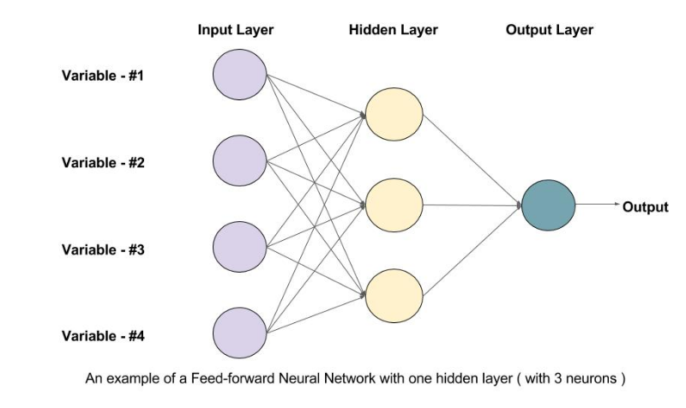

Slide 4
Structure of FNNs
Input Layer:
This layer consists of nodes (neurons) that represent the features of the input data.
Each node in the input layer corresponds to one feature in the dataset.
Hidden Layers:
These layers consist of neurons that apply transformations to the input data. A network can have zero or more hidden layers.
The neurons in the hidden layers are fully connected to the neurons in the previous and next layers.
Each neuron in a hidden layer applies a weighted sum of the inputs, adds a bias, and passes the result through an activation function.
Output Layer:
The final layer that produces the network's output.
The number of neurons in the output layer depends on the specific task (e.g., regression, binary classification, multi-class classification).

Slide 5
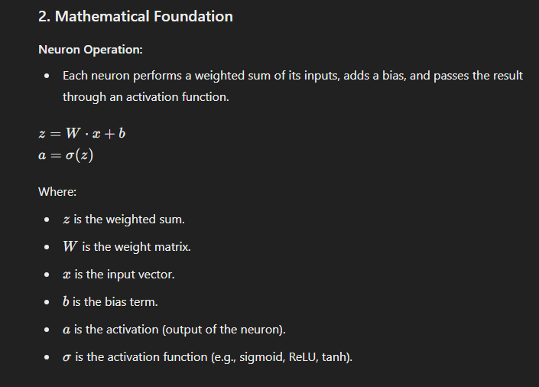

Slide 6
Training Feedforward Neural Networks

Slide 7
Forward Propagation
During forward propagation, inputs are passed through the network layer by layer to generate the output.
Each layer's output serves as the input to the next layer.
Loss Function:
The loss function measures the difference between the network's output and the true target values.
Common loss functions include Mean Squared Error (MSE) for regression tasks and Cross-Entropy Loss for classification tasks.

Slide 8
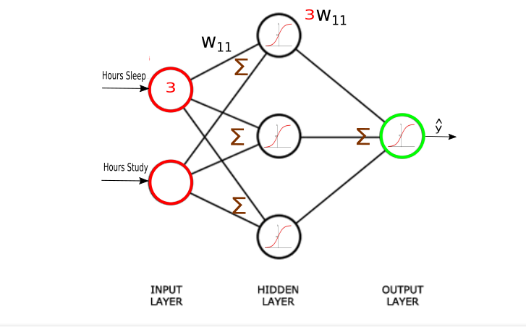

Slide 9
Backpropagation:
Backpropagation is the process of updating the network's weights to minimize the loss.
It involves computing the gradient of the loss function with respect to each weight and bias by applying the chain rule of calculus.
Optimization Algorithm:
An optimization algorithm like Gradient Descent or Adam is used to update the weights and biases based on the computed gradients.

Slide 10
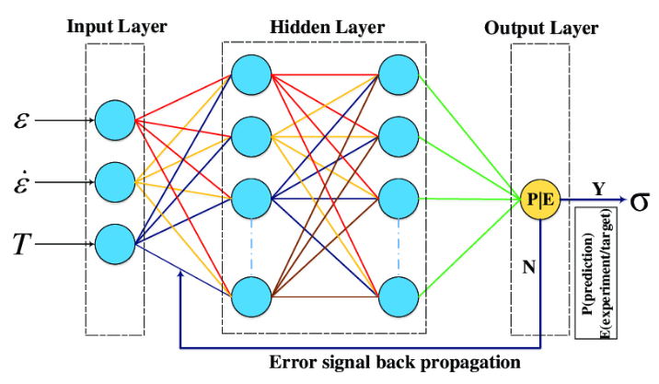

Slide 11
Types of FNNs
Single-Layer Perceptron:
Consists of a single layer of output neurons directly connected to the input layer.
Capable of solving linearly separable problems.
Multi-Layer Perceptron (MLP):
Consists of one or more hidden layers between the input and output layers.
Can solve non-linear problems by introducing non-linearity through activation functions in the hidden layers.

Slide 12
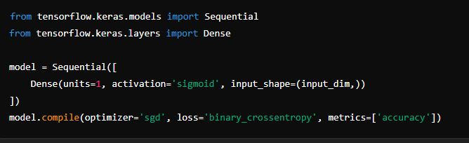
Single-Layer Perceptron (TensorFlow/Keras)

Slide 13
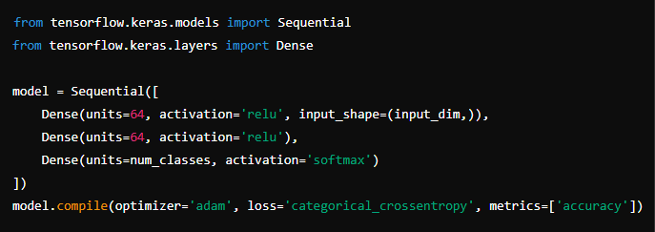
Multi-Layer Perceptron (TensorFlow/Keras)

Slide 14
5~minutes break

